Slide 1

GPU Virtualization on VMware’s Hosted I/O Architecture
Micah Dowty
Jeremy Sugerman
USENIX WIOV 2008
Notes:
- Quick introduction

Slide 2
Contents
GPUs are hard
But GPU virtualization is worth the trouble
How to virtualize a GPU?
VMware’s virtual GPU
Conclusions
In the paper:
  Details on our implementation
  Benchmarks, analysis
Notes:
Start out with background about GPUs, and we’ll talk about why you might want to virtualize one
Explain how GPUs differ from other devices that are often virtualized
-Explain how we see the space of possible GPU virtualization approaches
-Talk in more detail about our current approach: Implementation and benchmarks
-Conclusions...

Slide 3
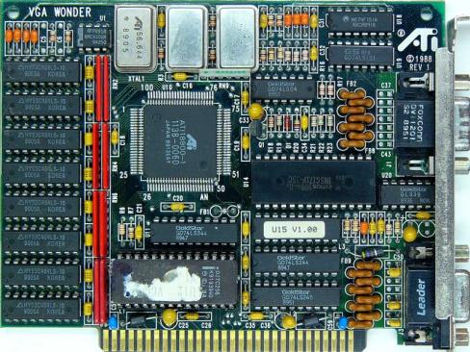
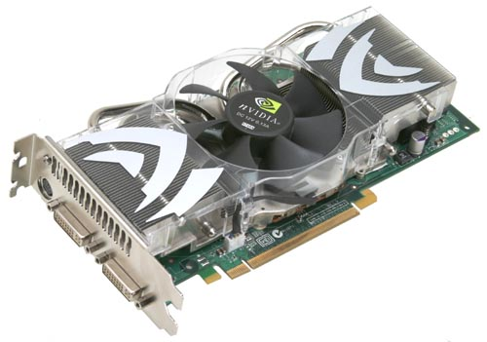
What is a GPU, anyway?
Video playback, 2D graphics, drawing triangles and rectangles and lines...
Computation.
Notes:
PC video cards have changed in the last couple decades
It’s no longer about video, it’s about computation
Despite this, virtualization usually ignores these aspects of video hardware

Slide 4
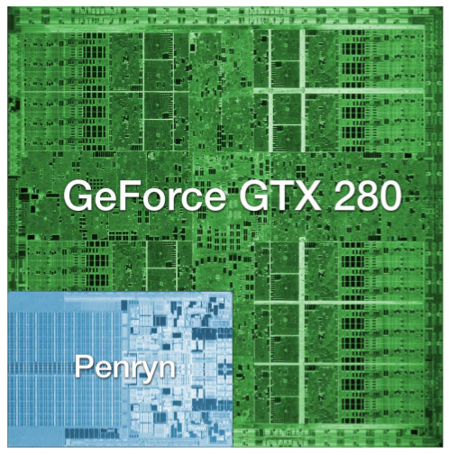
How much computation?
NVIDIA GeForce GTX 280:
1.4 billion transistors
Intel Core 2 Duo:
291 million transistors
Source: AnandTech review of NVidia GT200
Notes:
-Modern GPUs have more transistors, draw more power, and offer at least an order of magnitude more compute power than CPUs
-That’s a lot of wasted computation potential in virt solutions which don’t support the GPU.

Slide 5
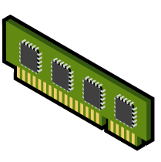
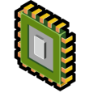
Programmable 3D Pipeline
Texture Data
Vertex Data
Vertex Pipeline
Rasterization
Pixel Pipeline
Framebuffer
Position
Material
Texture coordinate
Plot triangles, lines
Interpolate vertices
State
State
Vertex
Shader
Pixel
Shader
(State of the art circa 2002...)
Notes:
GPU hardware varies in implementaiton, but there are common API programming models
This is a typical GPU programming model
- Similar to DirectX 9 or OpenGL
- DX10 is a variation on this
- Compute APIs are totally different
GPU has memory, fixed-function hardware, and programmable hardware
Programming consists of data, state, and shaders (executable code)

Slide 6
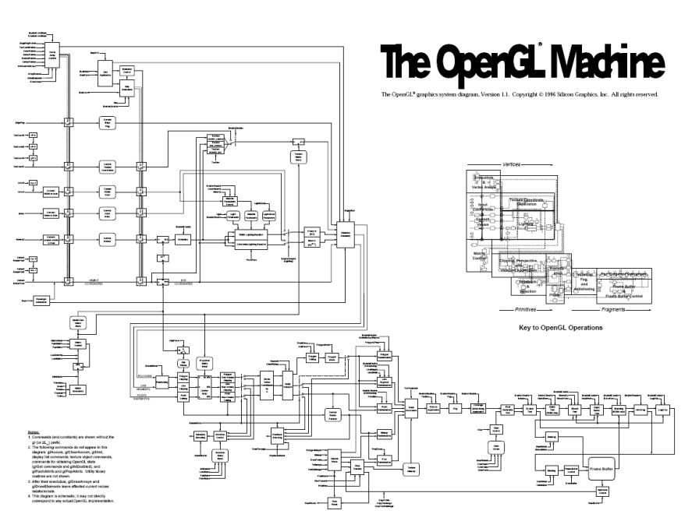
Unique challenges
API
  Not quite read(),
  write(), select()...
  Multiple competing APIs
  Hundreds of entry points
Programmable
  Every GPU driver is also a compiler
  Each API includes a language spec

Slide 7
Unique challenges
Hardware specs
  Diverse, changes frequently
  Closely guarded secret*
  Speed vs. portability
Hardware state
  Up to gigabytes of data
  Highly device-specific format
  In-progress DMA and computation
App
App
App
App
OpenGL
Direct3D
Compute
GPU Driver
GPU
* With a few notable exceptions.
Notes:
Note: API layer adapts complex/standard thing to simpler/nonstandard thing.

Slide 8
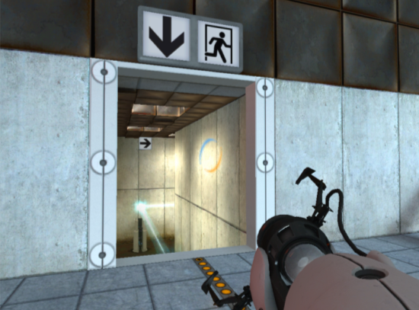
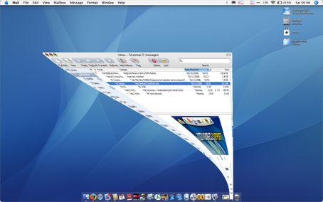
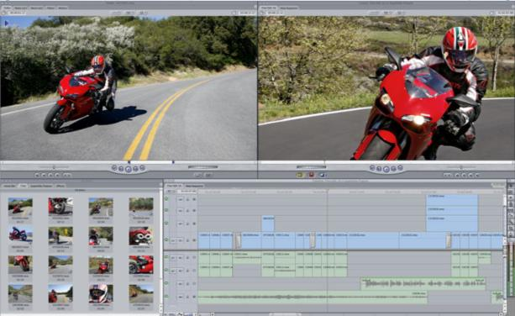
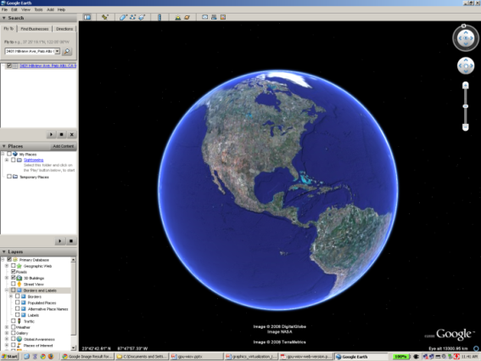
What are GPUs good for?
Desktop Apps
  Entertainment
  CAD
  Multimedia
  Productivity
Desktop GUIs
  Quartz Extreme
  Vista Aero
  Compiz
Notes:
-GPU technology is largely being driven by games
-But they’re also used by CAD apps, productivity apps like Google Earth, video processing
-And now, Windows, Mac OS, and Linux all have a user interface which supports GPU acceleration

Slide 9
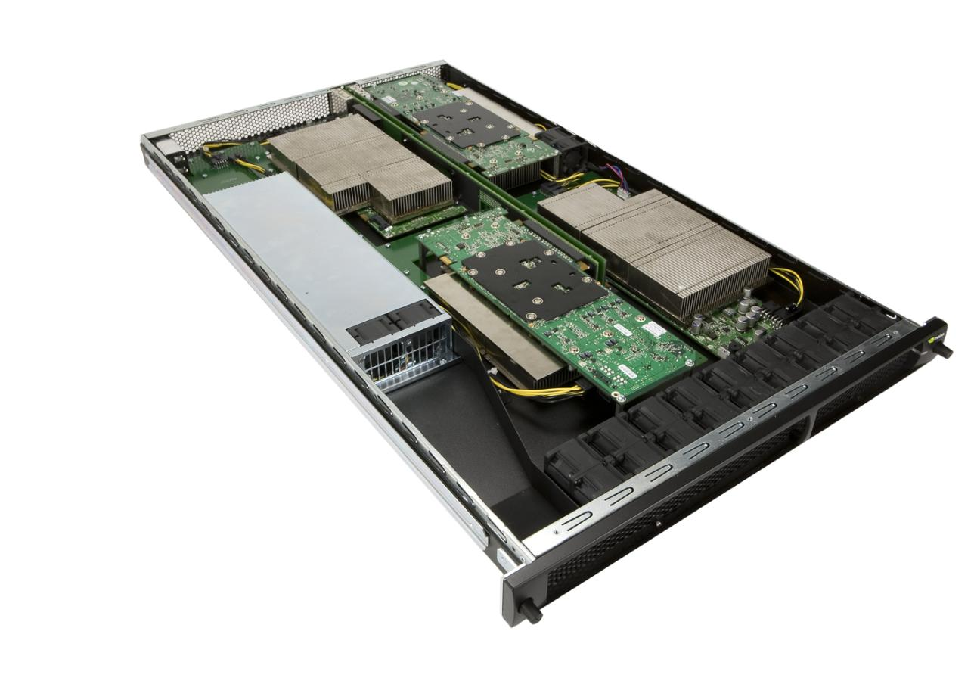
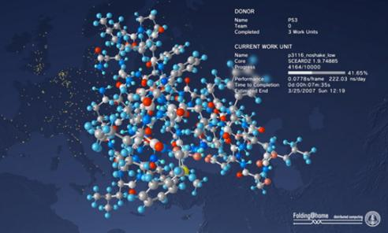
GPUs in the Data Center
Server-hosted Desktops
GPGPU
Notes:
-GPUs are currently most important on the desktop
- The use cases are consumer apps (Windows games on Mac), professional apps, and GPU-accelerated windowing systems
- This means that the most immediate need is for a hosted solution: coexists with the user’s existing OS
-But GPUs in the data center are also expected to emerge as an important solution space
- GPGPU apps (scientific, financial)
- Server-hosted virtual desktops

Slide 10
API Remoting
Guest
Host
App
App
App
RPC Endpoint
User-level
API
OpenGL / Direct3D Redirector
OpenGL / Direct3D
API
GPU Driver
Kernel
GPU
Hardware
Notes:
The simplest approach... (one extreme)
Analogous to full paravirtualization of a TCP offload engine.
Easy, but you get what you pay for.
Pro:
Easy to get working
easy to support new APIs/features
Con:
Hard to make performant (Where do objects live? When to cross RPC boundary? Caches? Batching?)
VM Goodness (checkpointing, portability) is really hard
Who’s using it?
Parallels’ initial GL implementation
Remote rendering: GLX, Chromium project
Open source “VMGL”: OpenGL on VMware and Xen
http://www.cs.toronto.edu/~andreslc/xen-gl/

Slide 11
Device Emulation
Guest
Host
GPU Emulator
Resource Management
User-level
Shader / State Translator
App
App
App
Rendering Backend
API
OpenGL / Direct3D
OpenGL / Direct3D
API
Kernel
Virtual GPU Driver
GPU Driver
Kernel
Virtual HW
Virtual GPU
GPU
Hardware
Shared System
Memory
Notes:
Another extreme: fully virtualize an existing physical GPU.
A classic virtualization technique, but it works really badly for graphics.
Pro:
Easy interposition (debugging, checkpointing, portability)
Thin and idealized interface between guest and host
Great portability
Con:
Extremely hard, inefficient
Very hard to emulate a real GPU
Moving target- real GPUs change often
At the mercy of vendor’s driver bugs

Slide 12
Fixed pass-through
Virtual Machine
OpenGL / Direct3D / Compute
App
App
App
API
GPU Driver
Pass-through GPU
DMA
MMIO
IRQ
PCI
VT-d
Physical GPU
Notes:
In theory, this is really easy...
Use VT-d to virtualize memory, pass nearly everything through
VM accesses GPU MMIO directly
GPU accesses guest memory directly
Pro:
Native speed
Full GPU feature set available
Should be extremely simple
No drivers to write
Con:
Need vendor-specific drivers in VM
No VM goodness: No portability, no checkpointing
(Unless you hot-swap the GPU device...)
The big one: One physical GPU per VM
(Can’t even share it with a host OS)

Slide 13
Mediated pass-through
Virtual Machine
Virtual Machine
OpenGL / Direct3D / Compute
OpenGL / Direct3D / Compute
App
App
App
App
App
App
API
API
GPU Driver
GPU Driver
Pass-through GPU
Pass-through GPU
Emulation
Emulation
GPU Resource Manager
Physical GPU
Notes:
Similar to “self-virtualizing” devices, but it may or may not require new hardware support. Some GPUs already do something similar to allow multiple unprivileged processes to submit commands directly to the GPU.
Now we divide the hardware GPU interface into two logical pieces...
One piece is virtualizable, and parts of it can be mapped directly into each VM.
Rendering, DMA, other high-bandwidth activities
One piece is emulated in VMs, and backed by a system-wide resource manager driver within the VM implementation.
Memory allocation, command channel allocation, etc.
(Low-bandwidth, security/reliability critical)
Pro:
Like fixed pass-through, native speed and full GPU feature set.
Full GPU sharing. Good for VDI workloads.
Little work for VMware to do: relies on GPU vendor hardware/software.
Con:
Need vendor-specific drivers in VM
Like fixed pass-through, “VM goodness” is hard
Little work for VMware to do... we have to wait on GPU vendors

Slide 14
GPU Virtualization Taxonomy
API Remoting
Device Emulation
Front-end
Hybrid
(Driver VM)
Back-end
Fixed Pass-through
1:1
Mediated Pass-through
1:N
Notes:
-In our paper, we present a taxonomy of solutions for virtualizing the GPU...
Major distinction is based on where we cut the driver stack.
Front-end: Hardware-specific drivers are in the host or hypervisor.
Good portability, mediocre speed.
Back-end: Hardware-specific drivers are in the VM.
Worse portability, good speed.
Back-end: Fixed vs. Mediated
Fixed: one device, one VM. Easy with an IOMMU
Mediated: Hardware-assisted multiplexing, to share one device with multiple VMs.
Requires modified GPU hardware/drivers (Vendor support)
Front-end
Continuum between two extremes
API remoting: replace API in VM with a forwarding layer. Marshall each call, execute on host.
Device emulation: Exact emulation of a physical GPU.
There are also hybrid approaches: For example, a driver VM using fixed pass-through plus API remoting.
Orange dot is our approach: We emulate a ficticious device, which was designed to be easy to virtualize. Its hardware interface is high-level and API-like.

Slide 15
VMware’s Virtual GPU
Compatibility
  Any physical GPU
  Any guest driver stack
  Adjustable capability
  exposure
  No direct access to
  GPU memory
Efficiency
  Flexible guest memory management
  Few copies
  Asynchronous rendering
Device Emulation
Resource Management
App
App
App
Shader / State Translator
Rendering Backend
OpenGL / Direct3D
OpenGL / Direct3D
Virtual GPU Driver
GPU Driver
VMware SVGA II
GPU
Notes:
-This implementation is designed to balance compatibility and efficiency
-Virtual device integrates well with existing driver stacks
-SVGA3D protocol strives to be API- and hardware-independent: maintains VM portability
-We can choose how much of the GPU’s feature set to expose, to assist VM portability
-No direct VRAM access: uses high-level host APIs
-Guest manages its own DMA memory
-Best case, only one extra copy
-Asynchronous operation of GPU is maintained

Slide 16
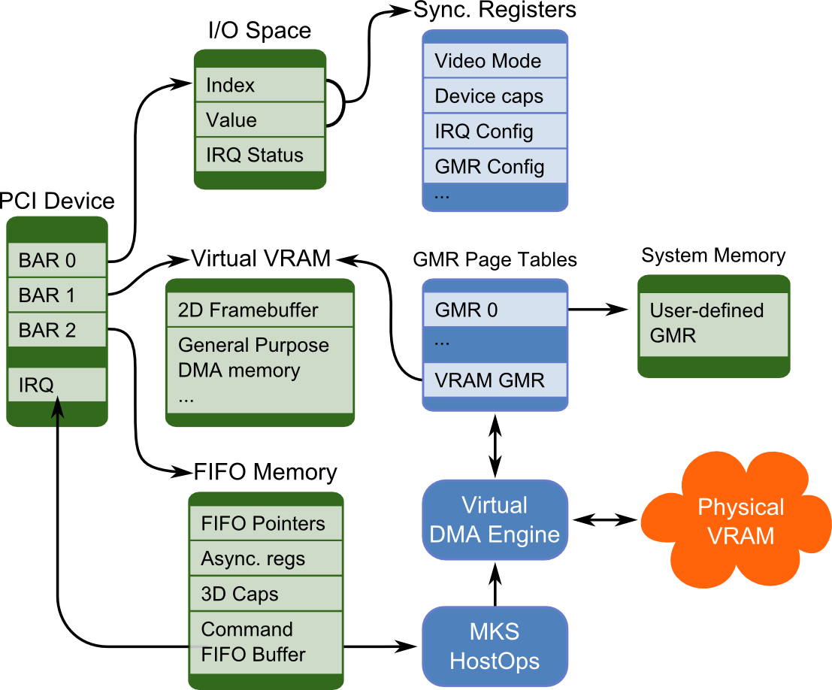
VMware SVGA II
Notes:
-This is a closer look at the virtual GPU device
-It’s a PCI device that we call “VMware SVGA II”
-Three BARs and an IRQ
-BAR0: I/O space. Synchronous. Only for legacy use, or ops that must be synchronous (like IRQ acknowledge)
-BAR1: “Virtual VRAM”. Actually just system memory. 2D framebuffer, plus general purpose DMA memory.
-BAR2: “FIFO memory”. Also system memory. Contains asynchronous registers, plus a command buffer. All rendering is performed by enqueueing commands.
-Includes FIFO synchronization primitives: measure host progress, deliver IRQ when host reaches a fence
-DMA between physical VRAM and guest memory regions (virtual VRAM, or system memory)

Slide 17
Virtual Graphics Stack
App
VMware SVGA Driver
Guest
Guest Mem
SVGA FIFO / Registers
Host
Guest VRAM
SVGA Device
MKS / HostOps Dispatch
SVGA GMR
2D
Compositing
3D
Rendering
2D
3D
State
Translator
Shader
Program
Translator
Surface
Abstraction
Video
DMA
Engine
3D Drawing Path
GPU API / Driver
GPU
Notes:
-This is a closer look at where FIFO commands go...
-All commands are executed asynchronously on the MKS (mouse, keyboard, screen) thread, represented by the dashed rectangle.
-Commands are dispatched to a platform-specific backend (OGL on linux/mac, D3D on win)
-On left side, a 2D portion of the backend does video acceleration, cursor, and 2D/3D compositing
-Right side does off-screen 3D rendering. Includes translators from SVGA3D state/shaders to host state/shaders
-Each drawing operation is a FIFO command
-Backend includes an idealized surface abstraction for managing physical video memory.
- DMA engine on right side emulates these idealized surfaces if necessary.
- Asks the GPU Driver to copy to/from maped guest memory

Slide 18
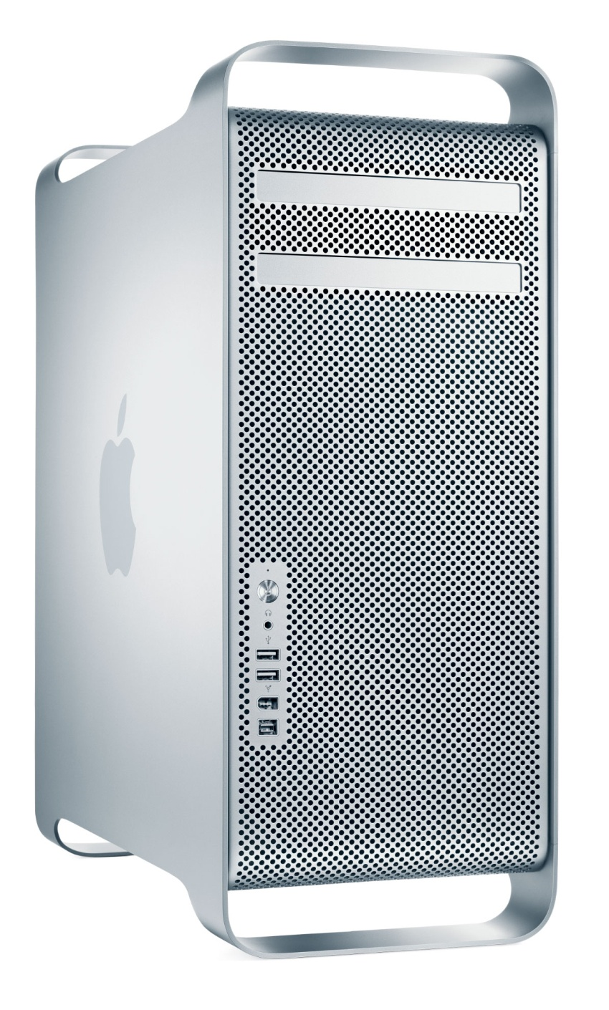
Evaluation
Applications
Microbenchmarks
VMware Fusion 2.0,
VMware Workstation 6.5,
Parallels Desktop 3.0,
SwiftShader
Mac Pro, 8-core 2.8 GHz
ATI Radeon HD2600
Notes:
-Evaluated with apps and some virtualization-focused microbenchmarks
-VMware Fusion for Mac and Workstation for Windows implement the above virtual GPU on OpenGL and Direct3D, respectively
-Parallels Desktop is another virtualization product for Mac OS. It uses a combination of the open source Wine API translator with their own OpenGL API remoting layer.
-Also compared against SwiftShader, the fastest available software renderer. Without GPU virtualization, this would be the fastest performance available in a VM.

Slide 19
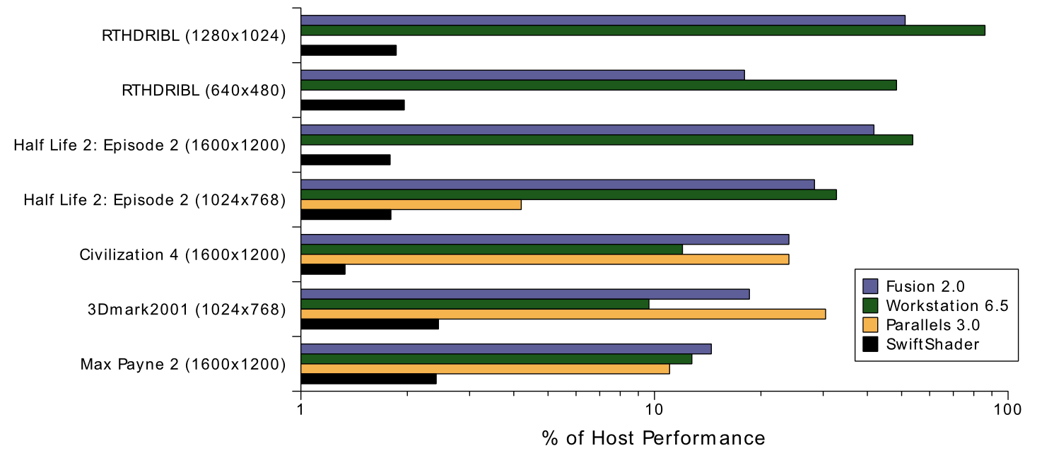
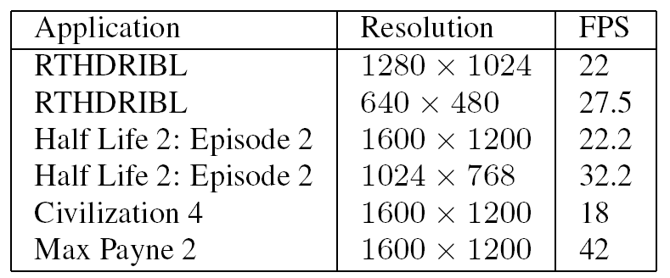
Application Benchmarks
Notes:
Relative performance of software rendering (SwiftShader) and three hardware accelerated virtualization
techniques. The log scale highlights the huge gap between software and hardware acceleration versus the gap between
virtualized and native hardware.
Absolute frame rates with VMware Fusion 2.0.
All applications run at interactive speeds (18–42 FPS).
Wide variation in performance:
- Some of this is due to increased per-DMA or per-draw overheads. Different game engines expose these overheads to different degrees.
- Most of it is just due to bugs or slow paths
(In our code, or the GPU vendor’s driver stack)

Slide 20
Summary
GPU Virtualization is an important problem
Room for improvement in implementation completeness and performance...
But we can already run interactive apps that could never be virtualized before
Virtual GPU preserves portability + isolation
Notes:
-GPU virtualization will be increasingly important
- More desktop virtualization
- More apps use GPUs
Bugs and inefficiencies in current implementations...
But it’s already working for real apps and users
Most importantly, we do this without sacrificing VM isolation or portability

Slide 21
Future Work
Pass-through techniques
  Fixed and Mediated
  Can be complementary to Virtual GPU
Continued improvements
  Performance and functionality
  At all layers of driver stack
Virtualization-aware GPU benchmarks
Notes:
This paper didn’t cover pass-through techniques. This is a really interesting research area, both for us and GPU vendors
There is a lot more that could be done on design and implementation at all graphics stack layers, to make our virtual GPU more efficient
Virtualized GPU performance can be hard to test accurately with current benchmarks. May be interesting to develop virt-aware benchmark tools

Slide 22
Questions?
micah@vmware.com

